Slide 1
System Analysis and Design
Eighth Edition
Alan Dennis, Barbara Wixom, Roberta M. Roth
Chapter 4
Understanding Processes with Use Cases and Process Models

Slide 2
Objectives
Understand the process used to identify business processes and use cases.
Understand the process used to create use‐case diagrams.
Understand the process used to model business processes with activity diagrams.
Understand the rules and style guidelines for activity diagrams.
Understand the process used to create use‐case descriptions.
Understand the rules and style guidelines for use‐case descriptions.
Be able to create functional models of business processes using use‐case diagrams, activity diagrams, and use‐case descriptions.

Slide 3
Introduction
A key aspect of determining the requirements for the new system is understanding the user requirements
The things the users need to accomplish with the new system
Use cases help us understand and clarify the users’ required interactions with the system and can help us more fully understand the functional requirements of the new system
A use case represents how a system interacts with its environment
Use cases are especially valuable for business system applications and websites
Process models have been a part of structured systems analysis and design techniques for many years

Slide 4
What Is a Use Case?
A use case depicts a set of activities performed to produce some output result
Each use case describes how an event triggers actions performed by the system and the user
Everything in the system can be thought of as a response to some trigger event

Slide 5
Basic Information
Each use case has a name and number, and brief description.
The priority may be assigned to indicate the relative significance.
The actor refers to a person, another system, or a hardware device that interacts with the system to achieve a useful goal.
The trigger for the use case – the event that causes the use case to begin.
Events triggers can be external or temporal

Slide 6
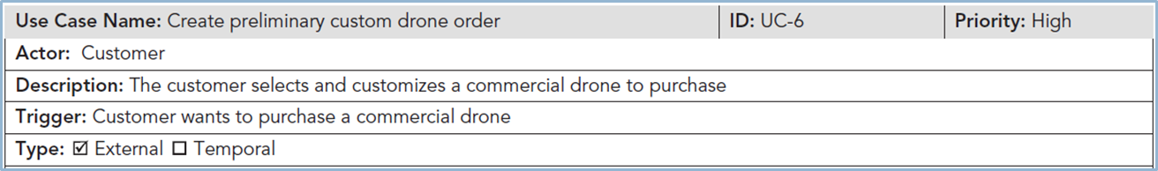
Create Preliminary Custom Drone Order Use Case—Casual Format

Slide 7
Preconditions
It is important to define clearly what needs to be accomplished before each use case begins
Preconditions define the state the system must be in before the use case commences

Slide 8
Normal Courses
The normal course lists the steps that are performed when everything flows smoothly in the system
Sometimes called the happy path

Slide 9
Postconditions
In this section of the use case, we define the final products of this use case
These postconditions also serve to define the preconditions for the next use case in the series

Slide 10
Exceptions
To be complete, a use case should describe any error conditions or exceptions that may occur as the use case steps are performed
These are not normal branches in decision logic but are unusual occurrences or errors that could potentially be encountered and will lead to an unsuccessful result
We want to be sure that the system does not fail while in use because of an error

Slide 11
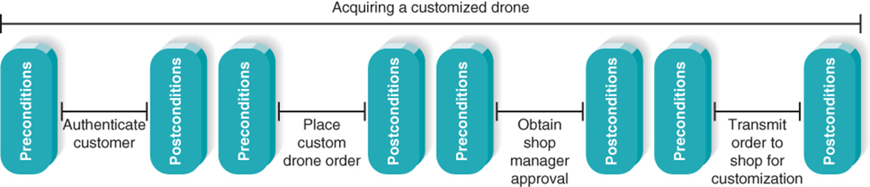
Use Cases in Sequence
Uses cases often performed in sequence
No single use case should be too large
Important to define initial and ending states

Slide 12
Additional Use Case Issues
Alternative paths
Summary of inputs and outputs
Frequency of use
Business rules
Special requirements
Assumptions
Notes and issues

Slide 13
More Elaborate Use Cases are Especially Valuable When…
User representatives are not actively engaged with the development team throughout the project
The application is complex and has a high risk associated with system failures
Comprehensive test cases will be based on the user requirements
Collaborating remote teams need a detailed, shared understanding of the user requirements

Slide 14
Use Case Practical Tips
Use gradual refinement
Concentrate on describing the user’s objectives with the system completely and accurately
Keep both audiences in mind – users and developers
Create use cases only when needed to clarify what the system must do from the user’s perspective
Not needed for simple events

Slide 15
Use Cases and the Functional Requirements
Use cases are useful tools to clarify user requirements
Use cases convey only the user’s point of view
Transforming the user’s view into the developer’s view through functional requirements is one of the system analyst’s key contributions
The derived functional requirements tell the developers more about what the system must do

Slide 16
Steps for Writing for Use Cases
Identify the use cases
Identify the major steps within each use case
Identify elements within steps
Confirm the use case

Slide 17
Creating Use Cases
Identify events the system must respond to – develop event-response list
Create use case form for the complex events
For each use case:
Identify the major steps
Identify elements with each major step (inputs and outputs)
Confirm use case with users through role-playing
Revise functional requirements as needed

Slide 18
Identify the Major Steps for Each Use Case
The analyst should ask the users what tasks need to be completed before the use case steps can begin
Next, the user–system interactions should be outlined as a series of steps in the Normal Course section of the form
Each step should be about the same size as the others
Occasionally, a use case is so simple that further refinement is not needed
Once the steps have been outlined at the proper level of detail, the postconditions can be completed

Slide 19
Identify Elements within Steps
The last column (“Information for Steps”) must be completed, and arrows may be drawn to describe inputs and outputs from the steps
The goal at this point is to identify the major inputs and outputs for each step
The users and analysts then return to the steps in the use case and begin tracing the flow of the steps
It is not unusual at this point for users to discover that they forgot to list the entire steps
The Summary area for inputs and outputs found at the end of the use case form is completed once the team is satisfied with the steps, inflows, and outflows

Slide 20
Confirm the Use Case
The final step is for the users to confirm that the use case is correct as written
Review the use case with the users to make sure that each step and each input and output are correct

Slide 21
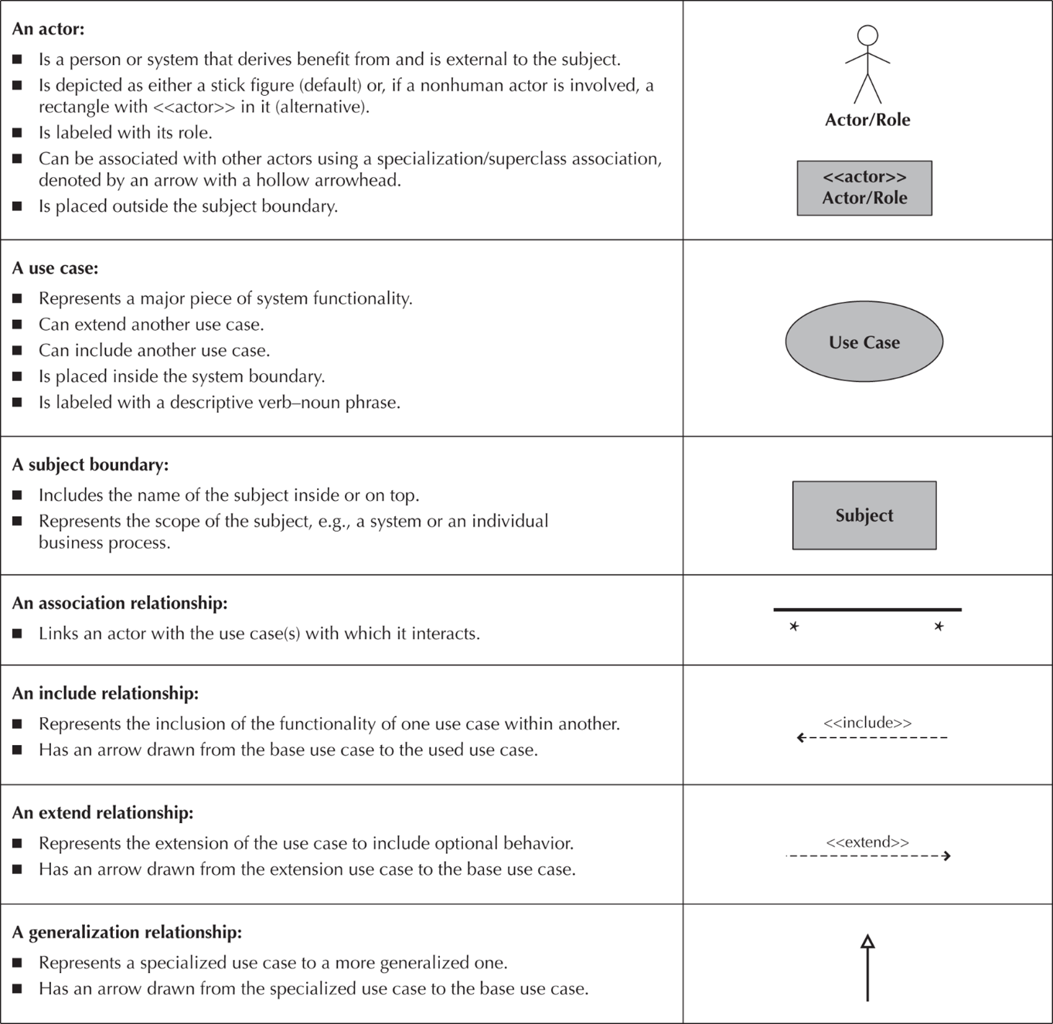
Use Case Diagrams - Elements

Slide 22
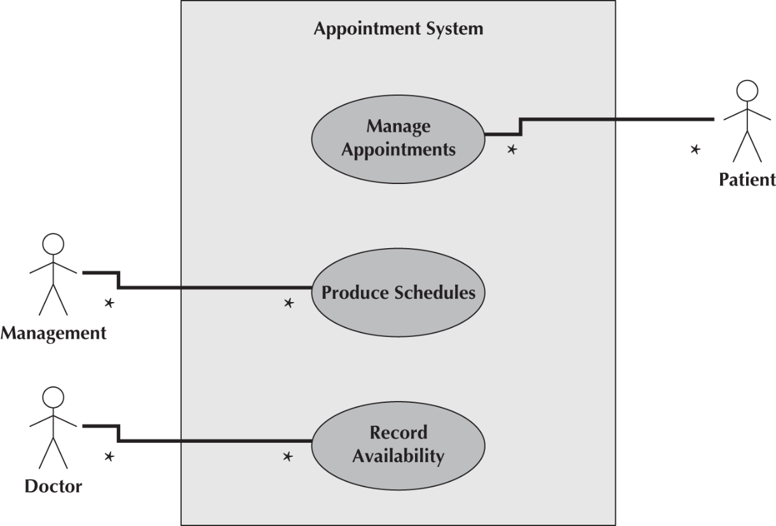
Use Case Diagrams
System Boundary

Slide 23
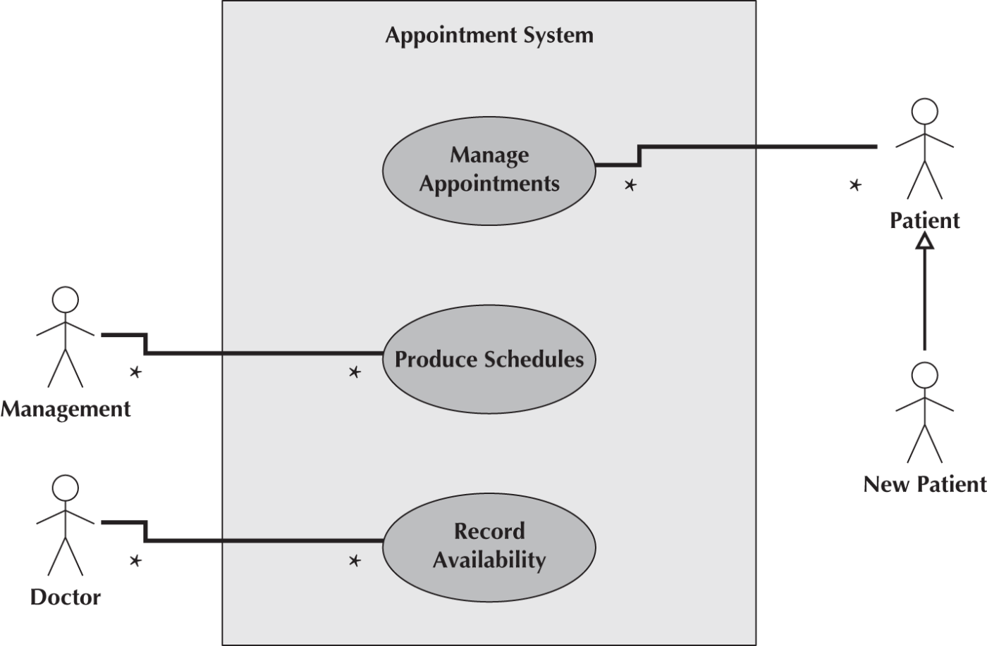
Use Case Diagram – Specialized Actor

Slide 24
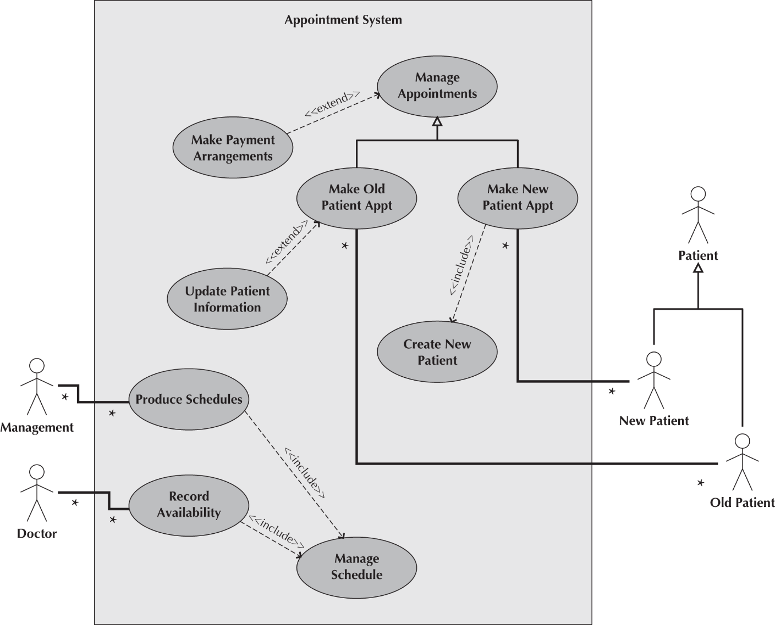
Use Case Diagrams – <<extends>> and <<includes>>
In practice
<<includes>> relationships are used to show the breakout of higher level Use Cases into Lower Level Use Cases
<<extends>> relationships are to show Uses Cases that are added after the initial development. Much like adding a new Class/Object in an Object Oriented

Slide 25
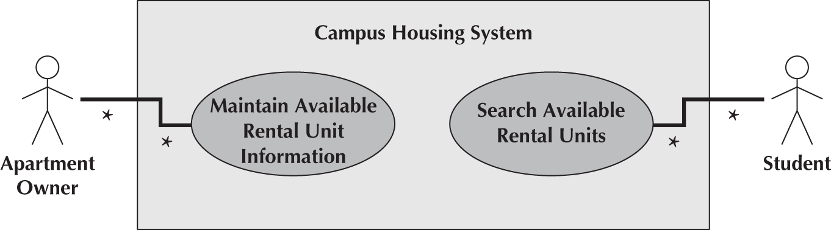
Use Case Diagrams - Example

Slide 26
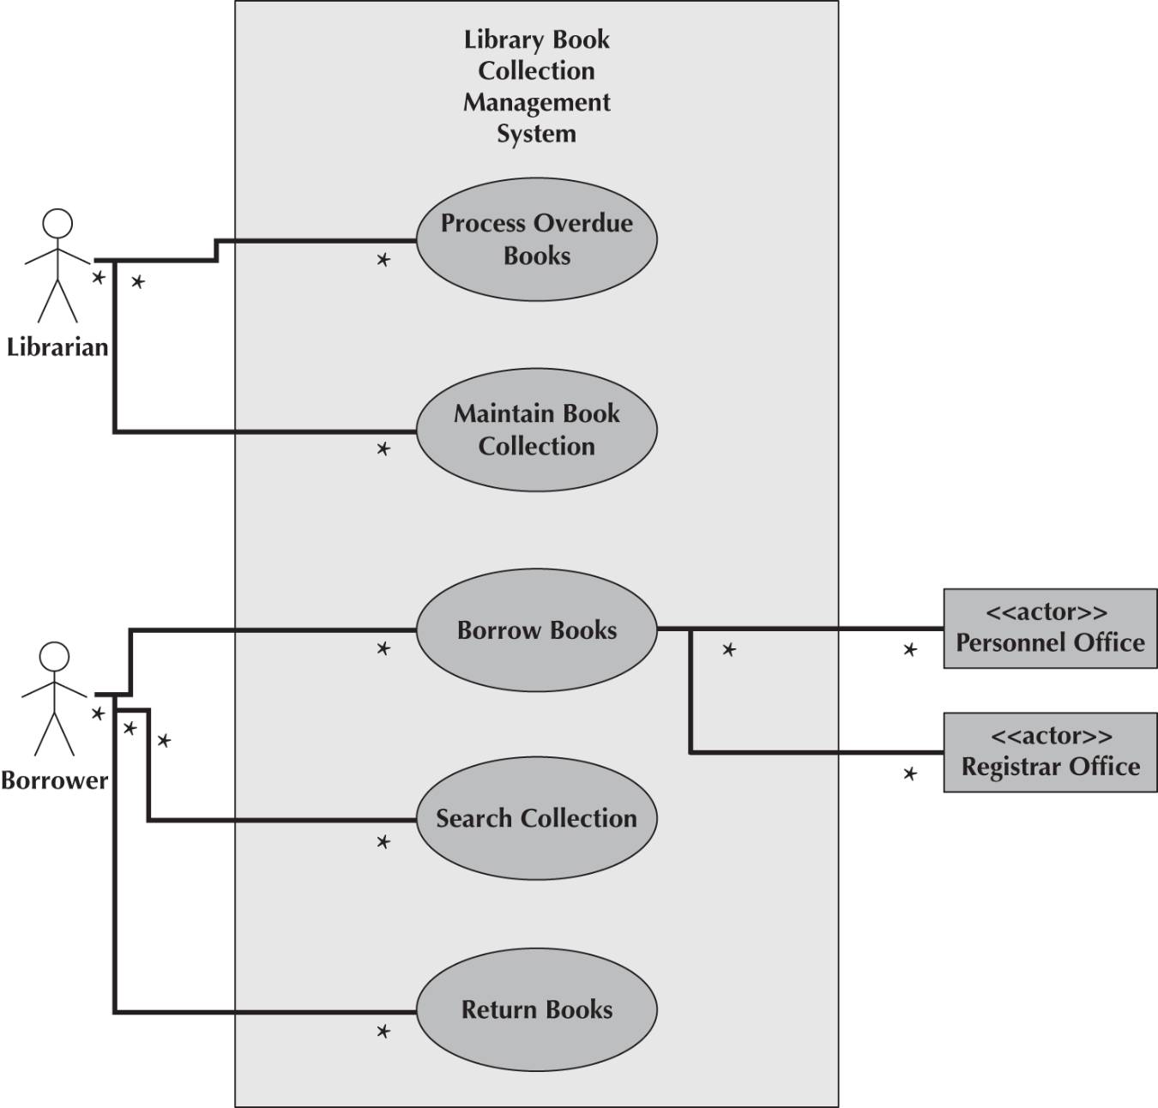
Use Case Diagram - Example
Non-human Actors

Slide 27
Control Flows and Object Flows
Control flows model the paths of execution through a business process.
A control flow is portrayed as a solid line with an arrowhead on it showing the direction of flow.
Control flows can be attached only to actions or activities.
Object flows model the flow of objects through a business process.
Because activities and actions modify or transform objects, object flows are necessary to show the actual objects that flow into and out of the actions or activities.
An object flow is depicted as a dashed line with an arrowhead on it showing the direction of flow.
An individual object flow must be attached to an action or activity on one end and an object node on the other end.

Slide 28
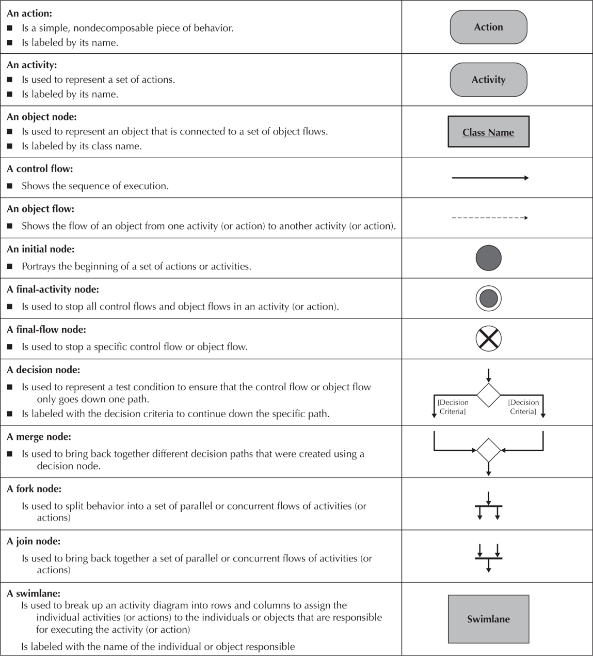
Activity Diagram Pallet

Slide 29
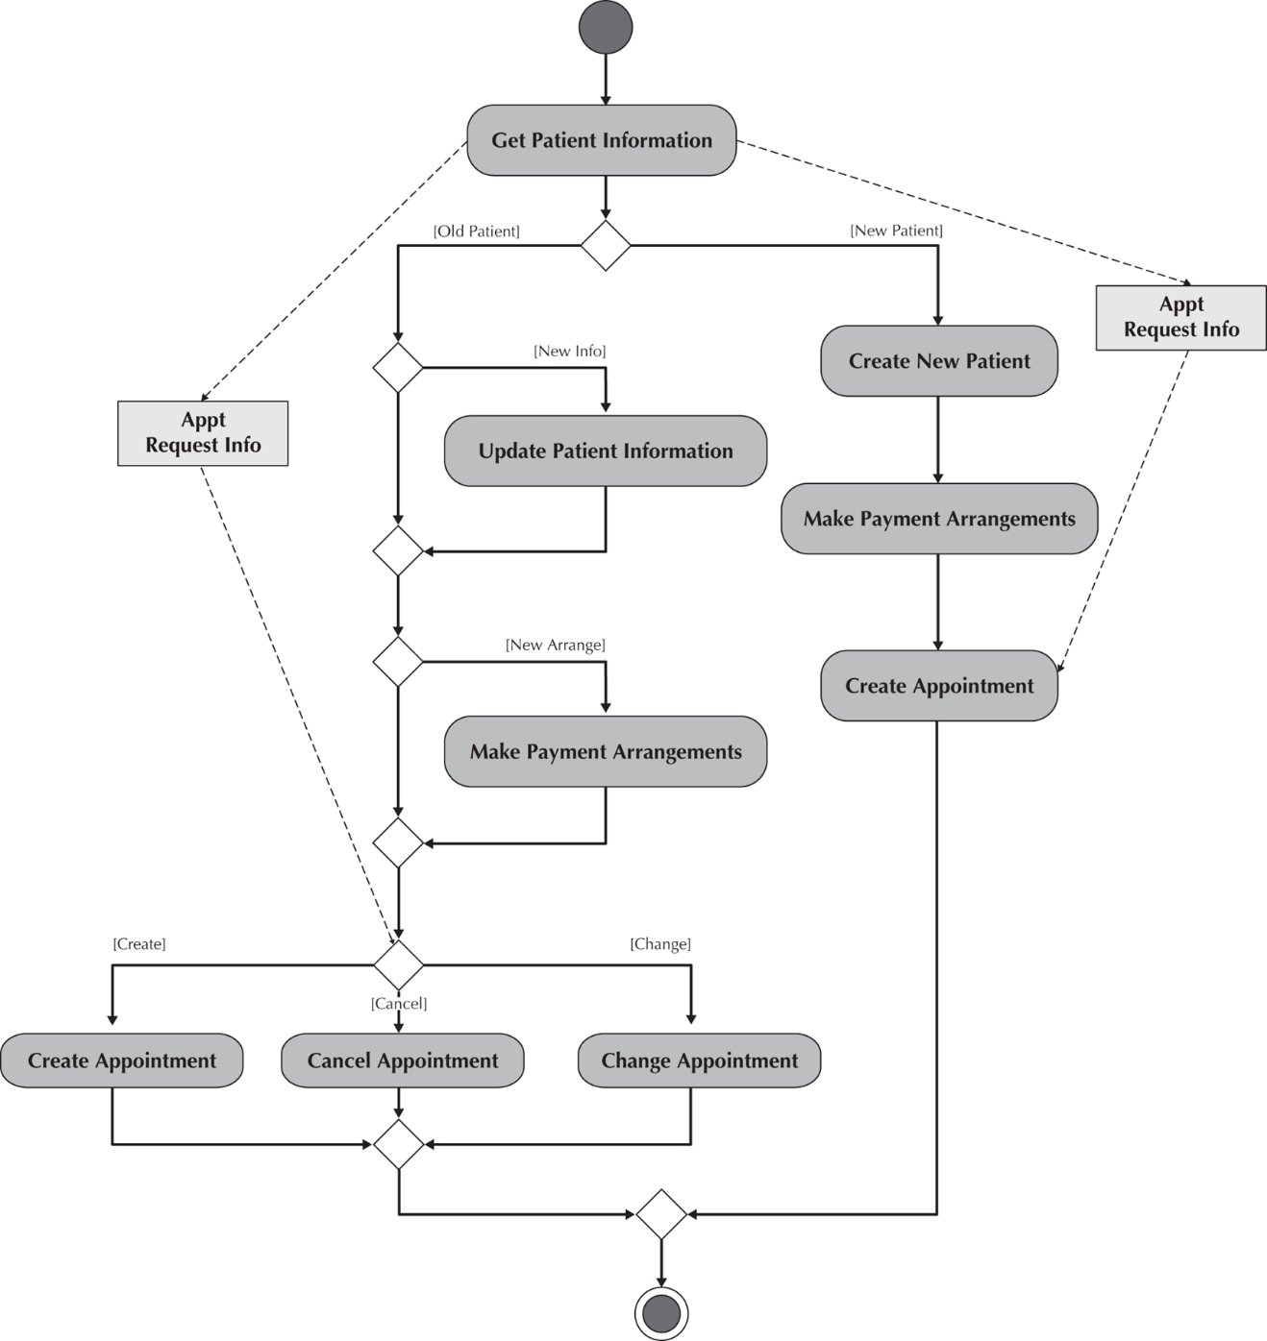
Activity Diagram for the Manage Appointments Use Case

Slide 30
Control Nodes
An initial node is shown as a small filled‐in circle.
A final‐activity node is used to stop the process being modeled.
A final‐flow node is similar to a final‐activity node, except that it stops a specific path of execution through the business process but allows the other concurrent or parallel paths to continue
The decision node is used to represent the actual test condition that determines which of the paths exiting the decision node is to be traversed.
A guard condition represents the value of the test for that particular path to be executed.
The merge node is used to bring back together multiple mutually exclusive paths that have been split based on an earlier decision

Slide 31
Control Nodes (Cont)
The fork node is used to split the behavior of the business process into multiple parallel or concurrent flows.
The join node simply brings back together the separate parallel or concurrent flows in the business process into a single flow.

Slide 32
Swimlane
Identifies activities that are dependent upon the object in the system that will be responsible for implementing it.
Can be drawn vertically or horizontally.

Slide 33
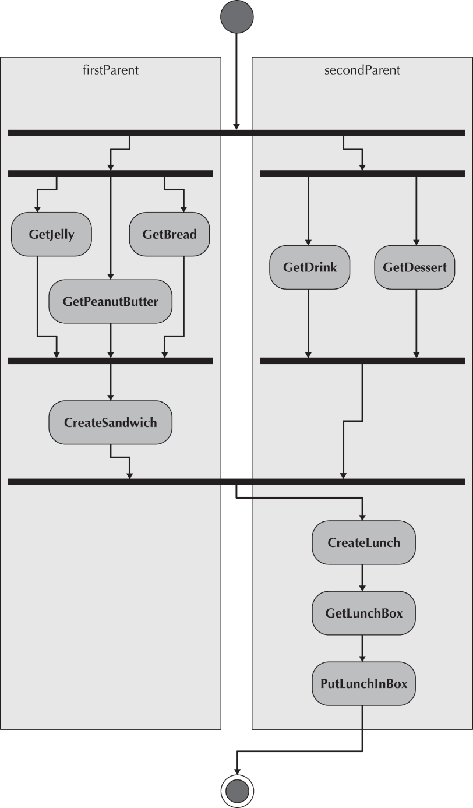
Swimlane (Cont)

Slide 34
Guidelines for Creating Activity Diagrams
Because an activity diagram can be used to model any kind of process, you should set the context or scope of the activity being modeled. Once you have determined the scope, you should give the diagram an appropriate title.
You must identify the activities, control flows, and object flows that occur between the activities.
You should identify any decisions that are part of the process being modeled.
You should attempt to identify any prospects for parallelism in the process.
You should draw the activity diagram.

Slide 35
Creating Activity Diagrams
Choose a business process that was previously identified to model. To do this, you should review the requirements definition and the use‐case diagram created to represent the requirements, as well as other relevant documentation
Identify the set of activities necessary to support the business process. These could/should come from the Use Cases themselves.
Identify the control flows and nodes necessary to document the logic of the business process.
Identify the object flows and nodes necessary to support the logic of the business process.
Lay out and draw the activity diagram to document the business process. For esthetic and understandability reasons, just as when drawing a use‐case diagram, you should attempt to minimize potential line crossings. Based on the previous steps and carefully laying out the diagram, the activity diagram in Figure 4‐8 was created to document the Manage Appointments business process.

Slide 36
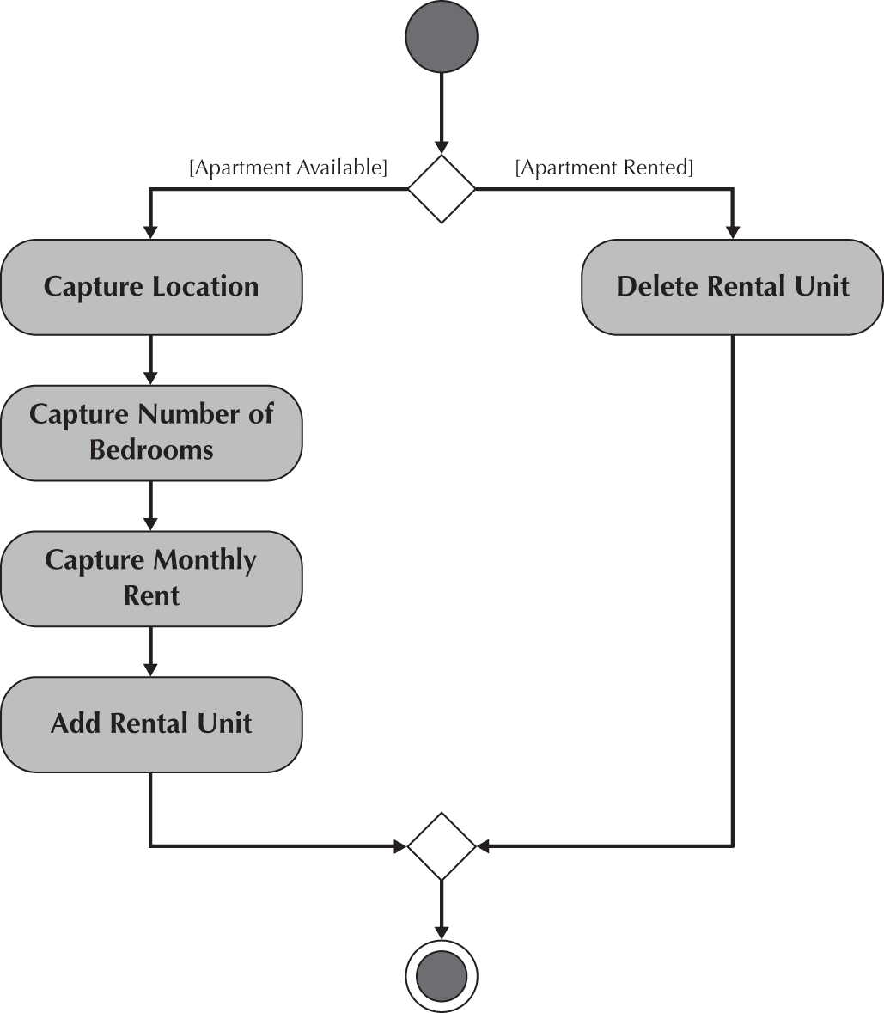
Campus Housing Activity Diagram
Maintain Available Rental Unit Information Use Case

Slide 37
Chapter Review (1 of 3)
Explain the purpose of a use case in the analysis phase of the SDLC.
Explain why use cases are commonly used in the analysis phase.
Discuss the various sections found in a use case form and the purpose and content of each section.
Explain how use cases help the systems analyst create a more in-depth understanding of the system’s functional requirements.
Describe how use cases can contribute to the development of test plans for the new system.

Slide 38
Chapter Review (2 of 3)
Discuss the four steps of the process used to create use cases.
Define the meaning and purpose of the four basic symbols found on a data flow diagram.
Explain the meaning and purpose of a process model’s context diagram.
Explain the meaning and purpose of a process model’s level 0 diagram.
Explain the meaning and purpose of a process model’s level 1 diagrams.

Slide 39
Chapter Review (3 of 3)
Explain the concept of decomposition and why process models are created as a hierarchy of DFDs.
Describe several common syntax and semantic errors found on DFDs.
Discuss the process used to create a process model.
Discuss how the process model contributes to the development of the new information system.

Slide 40
Key Terms
Actor
Balancing
Bundle
Children
Context diagram
Data flow
Data flow diagram
(DFD)
Data store
Decision tables
Decision trees
Decomposition
DFD fragment
Essential use cases
Event-driven modeling
Event triggers
External entity
External trigger
Happy path
IF statements
Inputs
Iteration
Layout
Level 0 diagram or level 0 DFD
Level 1 diagram, or level 1 DFD
Level 2 DFD
Logical process model
Outputs

Slide 41
Key Terms Continued
Parent
Physical model
Postconditions
Preconditions
Primary actor
Priority
Process
Processes
Process model
Role-play
Semantics error
Step
Structured English
Syntax error
Temporal trigger
Trigger
Use case
Use case packages
User requirements
User role
Viewpoint
Visualization

